Slide 1
The Role of Culture in Cognitive Development
PSYC 353 Lecture
Dr. Schwartz

Slide 2
Sociocultural Perspective
How we develop, particularly how we learn and think is primarily a function of the social and cultural environment in which we are reared.
Emphasizes what makes people different thinkers rather than what we share in common.

Slide 3

Consider the differences between children who grow up in a technologically driven society and children who grow up in a hunter-gatherer type of society in Africa…

Slide 4
According to Piaget, children will solve problems relevant to their daily lives using species-specific cognitive mechanisms that develop according to a species-typical schedule.

Slide 5
However,
Sociocultural theorists see cognitive development very differently
Cognitive development is inseparable from culture

Slide 6
Furthermore…
Culture is transmitted to children by their parents and other members of society.
Children’s intellectual processes are developed to handle tasks and problems important to the particular surroundings.
Sociocultural theory addresses how children come to understand their and function in their social world.

Slide 7




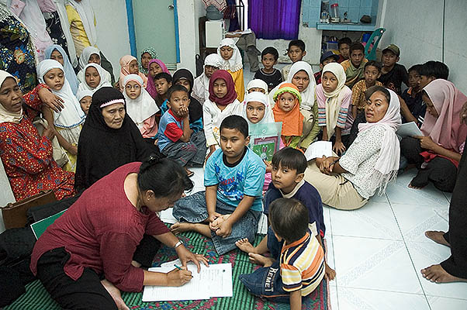


Slide 8
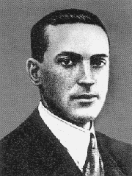
Lev Vygotsky
Russian Psychologist (1896 – 1934), died at 38 from Tuberculosis.
His writing in the 20’s and 30’s emphasized that development is guided by adults interacting with children, with culture determining how, where, and when these interactions take place.

Slide 9
Vygotsky
Proposed that cognitive development occurs in situations where a child’s problem solving is guided by an adult.
Cognitive development progresses through the collaborations of members of one generation with another.
Cognitive development is embedded within culture.

Slide 10
Vygotsky - Genetic Method
Another of Vygotsky’s key ideas is his “genetic” domains:
Onto-genesis: Development by an individual over lifetime
Socio-historical: Development of the society
Phylo-genesis: Development of the (human) species
Micro-genesis: Creation of ideas & concept learning
Focusing only on the individual or only on the environment cannot provide an adequate explanation of development.
Therefore, his social theory involves the interplay between 1 and 2.

Slide 11
Tools of Intellectual Adaptation
Infants are born with some elementary mental functions.
  Attention, sensation, perception, and memory.
Transformed by the culture into new and sophisticated mental processes—higher mental functions

Slide 12
Tools of Intellectual Adaptation
Thinking and problem solving strategies that children internalize from their interactions with more competent people.
Teach children how to use their minds –how to think and what to think.

Slide 13
Vygotsky on Cognition
Cognition—even in isolation, is socioultural.
Affected by values, beliefs and tools of intellectual adaptation transmitted to individuals by their culture.
Varies from culture to culture, therefore, not universal as Piaget assumed.

Slide 14
Cognitive Development
Young children are curious explorers
  Active in learning and discovering new principles
Importance of social contributions to cognitive growth
Higher psychological processes (involve social awareness) have a social origin, developing first on a social plane and then later internalized on a psychological plane.

Slide 15
Dual Nature of Cognitive Development
General Genetic Law of Cultural Development
Social Plane
Psychological Plane
~
Between people as an interpsychological category
Within the child as a intrapsychological category

Slide 16
Culturally Constituted Cognitive Activity
Cognitions are not characteristics of individuals, but are functions that can be carried out between individuals.
Individual thinking is embedded within the contributions of the social world.
Vygotsky suggested that individuals be examined as they participate in culturally valued activities.

Slide 17
Many important discoveries that children make occur within the context of cooperative and collaborative dialogues between a skillful tutor.
Child tries to understand the instructions and internalizes the information to regulate his own performance.
Fosters cognitive growth.

Slide 18
Zone of Proximal Development
The difference between a child’s “actual developmental level as determined by independent problem solving” and the level of “potential development as determined through problem solving under adult guidance or in collaboration with more capable peers”.

Slide 19
Zone of Proximal Development
Actual developmental level as determined through problem solving under adult guidance or in collaboration with more capable peers
Actual developmental level as determined by independent problem solving.
The
ZPD
Children learn best when they solve problems at a level between their current ability and their ability when assisted by a more competent person

Slide 20
Zone of Proximal Development

Slide 21
Zone of Proximal Development
Instruction should occur within the zone.
Effective teaching should be focused here.
Cognitive growth occurs here.

Slide 22
Scaffolding
When an expert is aware of the abilities of a novice and responds contingently to the novice’s responses so that the novice eventually increases his or her understanding of the problem.

Slide 23
In other words…
Scaffolding is an instructional technique where the teacher provides the novice learner with just enough assistance for achievement of understanding.
Students receive help that enables them to complete tasks that they cannot complete independently.

Slide 24
Gradually, as the learner becomes more proficient, the scaffolding is removed.
However, studies show that students do not learn as well when told everything to do, nor when left alone to discover on their own.

Slide 25
Adult Child Interactions
Vary with culture
  What is taught depends on what roles the child is expected to play eventually in society

Slide 26
Rogoff
The transaction between adults and children reflects an apprenticeship in thinking.
Improving skills and understanding through participation with more skilled partners.

Slide 27
Guided Participation
Extending the Zone of Proximal Development
Refers to adult-child interactions during routine activities of everyday life. (not just explicit instruction)
  Going to the post office, dry-cleaners, supermarket…
Communicating and engaging in shared activities with others

Slide 28
Furthermore…
It focuses on the daily activities in children’s lives
  Chores, watching television…
Rogoff believed that children’s cognitions are shaped from these routine day-to-day activities more so than in formal education settings.

Slide 29
Consider the differences between children who grow up in a technologically driven society and children who grow up in a hunter-gatherer type of society in Africa…

Slide 30
Tribal-type cultures may involve children in the daily activities of life more so than children growing-up in an information-age culture.
Cognitive development has been shifted from the parents to professional educators.
Context-independent learning
  Knowledge for knowledge’s sake

Slide 31
Language Development
All children acquire language at about the same time.
In the U.S. and most of the developed world, parents talk to their young children and include them as conversational partners.
  Preparation for formal schooling

Slide 32
Reading Development
Joint reading activity: A parent who reads to their child regularly is a good predictor of the child’s reading ability later in life.
  TV vs. Reading
Interactive Story Reading
  Stopping periodically to ask open-ended questions
  Asking progressively more challenging questions

Slide 33
Symbolic Play
Pretending – all children do this
Can be solitary or cooperative
Chair race car

Slide 34
Symbolic Play
Requires the child to form a mental representation of the activity
  An indicator of a child’s general cognitive development
Children advance their cognitions about people, objects, and actions
Constructing an increasingly sophisticated representation of the world and how it works

Slide 35
Play it again…
When a child who interacts with a more skilled partner who structures the situation appropriate for them, then they advance in their skills faster than when this support is not provided.
Relationship between the amount of cooperative social play that preschooler’s engage in and their later understanding of people’s feelings and beliefs.

Slide 36
Two Types of Cultures
Like ours – beginning in preschool, children are often segregated from adults and receive culturally important information and instruction outside of the context of skilled activities.
Cultures where children are in close contact with adults for most of the day and observe and interact with adults while they perform culturally important activities

Slide 37
Different Trajectories
Different forms of guided are going to be used for different cultures
  Depends on the demands of the cultures
Cultural beliefs and technological tools influence cognitive development through child-rearing practices.

Slide 38
Educational Implications
Vygotsky stressed active learning
  Assessing what they already know
  Establishing what they are capable of learning
Allowing teachers to teach within the zone
Allowing teachers to provide sufficient scaffolding for fostering growth and development

Slide 39
Guided Participation in the Classroom
Where teachers
  Structure learning activities
  Provide helpful hints or instruction
  Carefully tailored to child’s abilities
  Monitoring learner’s progress
  Gradually turning over more mental activity to the students

Slide 40
Cooperative Learning Environments
Design exercises where students are encouraged to help each other
Less competent students will benefit from the instruction of more competent peers
Teaching somebody something is the best way to solidify one’s own knowledge
Problem solving skills advance when working together more so than when working alone

Slide 41
Studying for your exams
Is not fun…
But can be more fun when done in a group
  Best in a dyad
  Taking turns teaching each other the subject matter

Slide 42
Why?
Motivation is increased
Use more high quality cognitive and metacognitive stratagies
Increases your overall understanding
Clears-up any confusion
Builds a solid knowledge foundation

